Slide 1
Cal Marples
16th October 2025

Slide 2
Vertex model with internal dissipation
enables sustained flows
Jan Rozman, KVS Chaithanya, Julia M. Yeomans, Rastko Sknepnek
Nature Communications, Vol. 16, No. 530, January 2025
DOI: https://doi.org/10.1038/s41467-025-55820-2

Slide 3
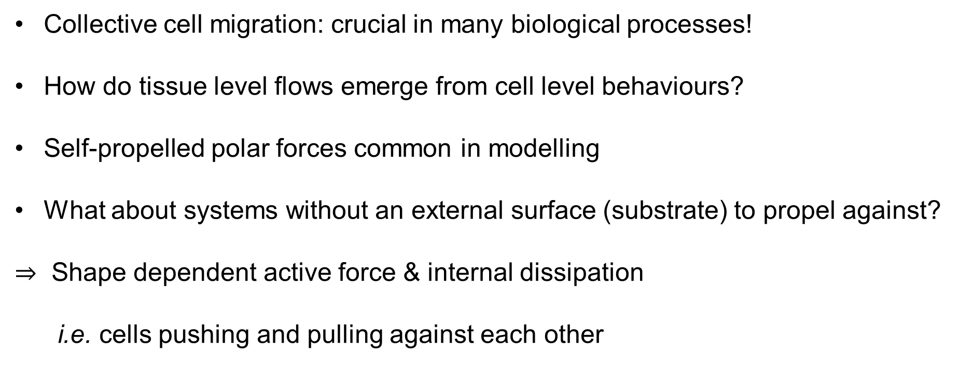
Introduction
Collective cell migration: crucial in many biological processes!
How do tissue level flows emerge from cell level behaviours?
Self-propelled polar forces common in modelling
What about systems without an external surface (substrate) to propel against?
$⇒$ Shape dependent active force & internal dissipation
i.e. cells pushing and pulling against each other

Slide 4
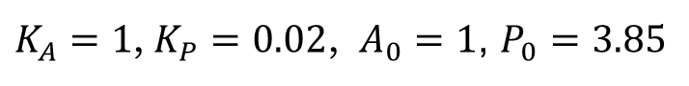

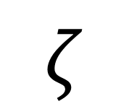
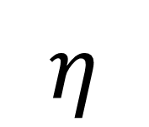

The Vertex Model
$$E=\sum_{cell i}{\left[\frac{K_{A}}{2}{\left(A_{i}−A_{0}\right)}^{2}+\frac{K_{P}}{2}{\left(P_{i}−P_{0}\right)}^{2}\right]}$$
Hamiltonian:
$K_{A}=1$, $K_{P}=0.02$, $A_{0}=1$, $P_{0}=3.85$
Active force
Dissipation model
Substrate
Internal
Depends on cell shape anisotropy
No preferred direction of motion!
Director
$$ζ$$
$$ξ$$
$$η$$
Activity strength
Substrate friction
Internal friction

Slide 5
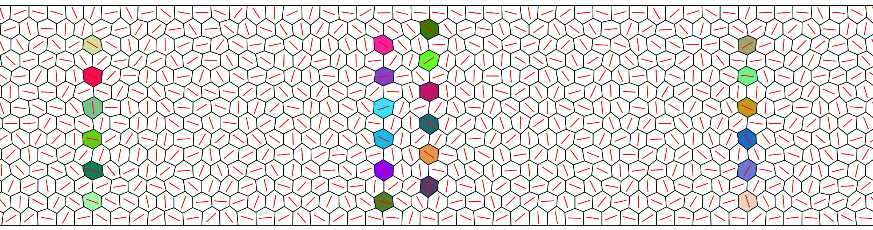
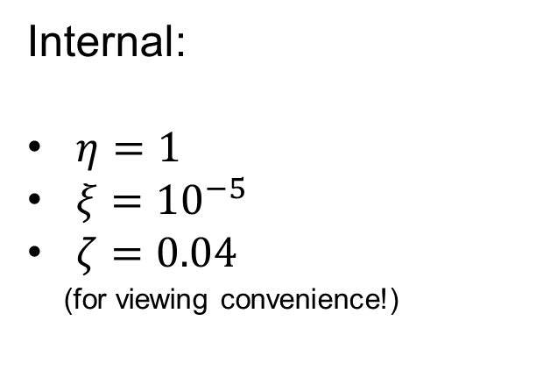
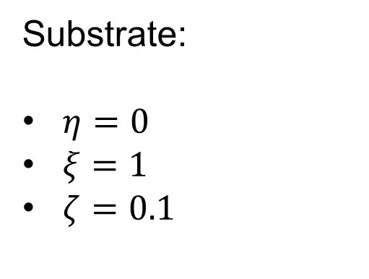
Substrate vs. Internal Dissipation
Substrate:
$η=0$
$ξ=1$
$ζ=0.1$
Internal:
$η=1$
$ξ={10}^{−5}$
$ζ=0.04$
(for viewing convenience!)

Slide 6
Velocity Profiles
Simulation snapshots at time $t=2×{10}^{5}$
Velocities at discrete sites averaged between $t={10}^{5}$ and $2×{10}^{5}$

Slide 7
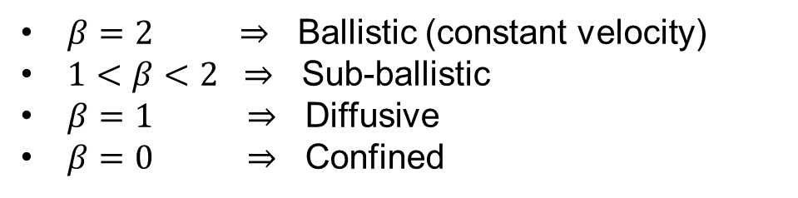
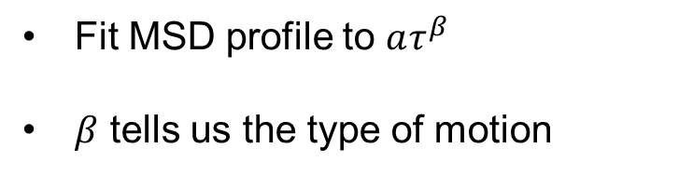
Mean Square Displacement
Fit MSD profile to $aτ^{β}$
$β$ tells us the type of motion
$β=2 ⇒$ Ballistic (constant velocity)
$1<β<2 ⇒$ Sub-ballistic
$β=1 ⇒$ Diffusive
$β=0 ⇒$ Confined

Slide 8
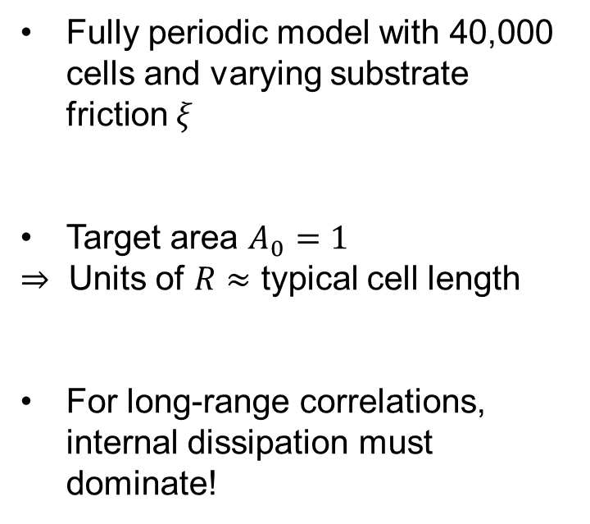
Length Scales
Correlation function
how does the value of a quantity at one location relate to the value somewhere else?
Fully periodic model with 40,000 cells and varying substrate friction $ξ$
Target area $A_{0}=1$
$⇒$ Units of $R≈$ typical cell length
For long-range correlations, internal dissipation must dominate!

Slide 9
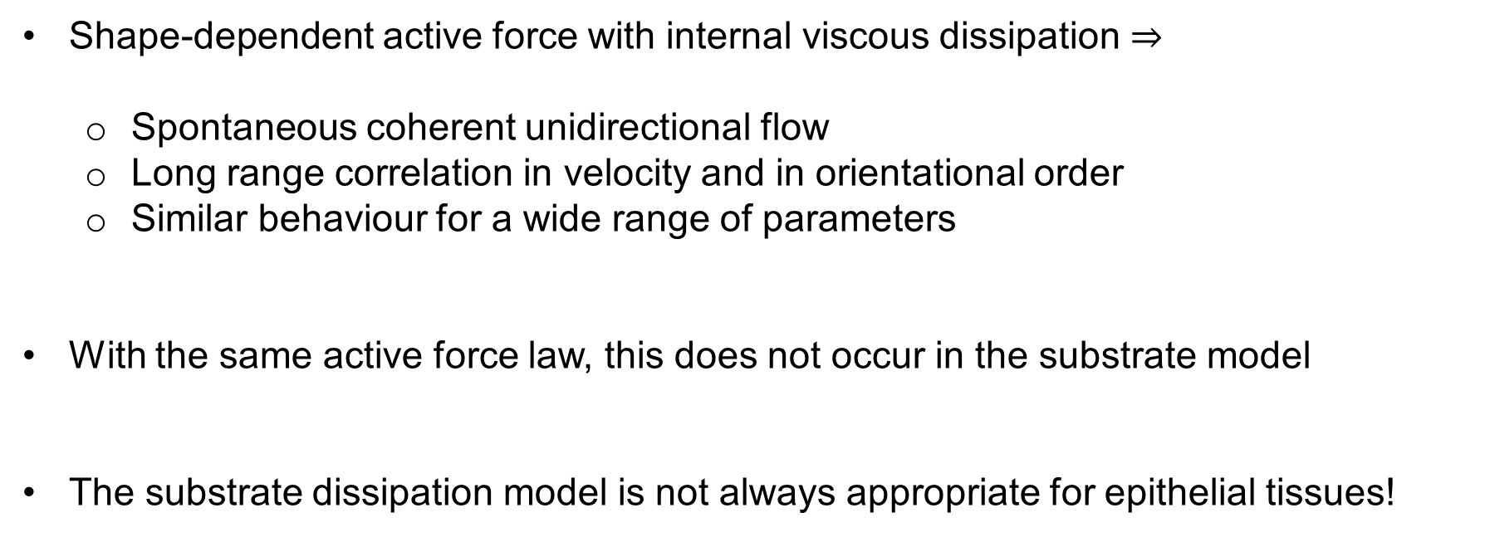
Summary
Shape-dependent active force with internal viscous dissipation $⇒$
Spontaneous coherent unidirectional flow
Long range correlation in velocity and in orientational order
Similar behaviour for a wide range of parameters
With the same active force law, this does not occur in the substrate model
The substrate dissipation model is not always appropriate for epithelial tissues!

Slide 10




Who uses Greek letters?
$$ξ$$
$$ζ$$
Physicists
Mathematicians
$$η$$
$$β$$
Greeks

